Slide 1
Web Server and Web Browser
Web servers and web clients work together in a client–server model, where the client (typically your web browser) requests resources, and the server provides those resources over a network using protocols like HTTP. Here’s a step-by-step breakdown of how they interact

Slide 2
How to work protocol
Protocols are essential for communication between devices in a network. They define rules for syntax, semantics, and timing to ensure data is transmitted accurately and efficiently. Let’s break down each aspect in detail.
Syntax
Syntax refers to the structure and organization of data in a protocol. It defines how data is packaged and formatted before transmission
Headers – Metadata added at the beginning of a packet (e.g., source & destination addresses, sequence number).
Payload – The actual data being transmitted.
Footers – Additional information at the end of a packet (e.g., error-checking )

Slide 3
Semantics
Semantics refers to the meaning behind each part of a message and the actions that should be taken.
Error Handling – Defines how errors are detected and corrected (e.g., TCP retransmits lost packets).
Control Information – Includes flow control, congestion control, and acknowledgments.
Response Mechanisms – Specifies how the receiver should respond (e.g., HTTP 200 OK, 404 Not Found).
TCP Semantics
TCP uses acknowledgments and retransmission for reliability:
Sender: Sends a packet with sequence number 1001.
Receiver: Acknowledges receipt (ACK 1002).
Sender: If no acknowledgment is received, it resends the packet.

Slide 4
Timing
Timing ensures that communication occurs at the correct speed, in the right order, and with proper synchronization between sender and receiver.
Synchronization – Ensures devices agree on when and how data is exchanged.
Transmission Rate – Controls data flow to prevent congestion.
Order of Messages – Maintains correct sequencing (e.g., TCP assigns sequence numbers to packets).
TCP 3-Way Handshake (Synchronization in TCP)
Before sending data, TCP establishes a connection using a 3-way handshake:
SYN (Synchronize) – Client requests a connection.
SYN-ACK (Synchronize-Acknowledge) – Server acknowledges and responds.
ACK (Acknowledge) – Client confirms, and data transfer begins.
Notes:
TCP (Transmission Control Protocol) is one of the core protocols of the Internet Protocol (IP) suite. It provides reliable, ordered, and error-checked delivery of data between applications running on networked devices. It is widely used for applications like web browsing (HTTP/HTTPS), email (SMTP, IMAP, POP3), and file transfers (FTP).
How TCP Works?
TCP works using a process called the Three-Way Handshake to establish a reliable connection before data transmission. Here’s how it works:
Connection Establishment (Three-Way Handshake)
Step 1 (SYN): The client sends a SYN (synchronize) packet to the server to request a connection.
Step 2 (SYN-ACK): The server responds with a SYN-ACK (synchronize-acknowledge) packet to confirm the request.
Step 3 (ACK): The client sends an ACK (acknowledge) packet, and the connection is established.
Data Transmission
TCP breaks data into packets.
Each packet has a sequence number so that they can be reassembled in the correct order.
The receiver sends an ACK for each packet received.
If a packet is lost, TCP retransmits it to ensure reliability.
Connection Termination
When communication is complete, the connection is closed using a four-step FIN-ACK process:
Client sends FIN (finish) request.
Server acknowledges with ACK.
Server sends its own FIN.
Client responds with ACK, and the connection is closed.

Slide 5
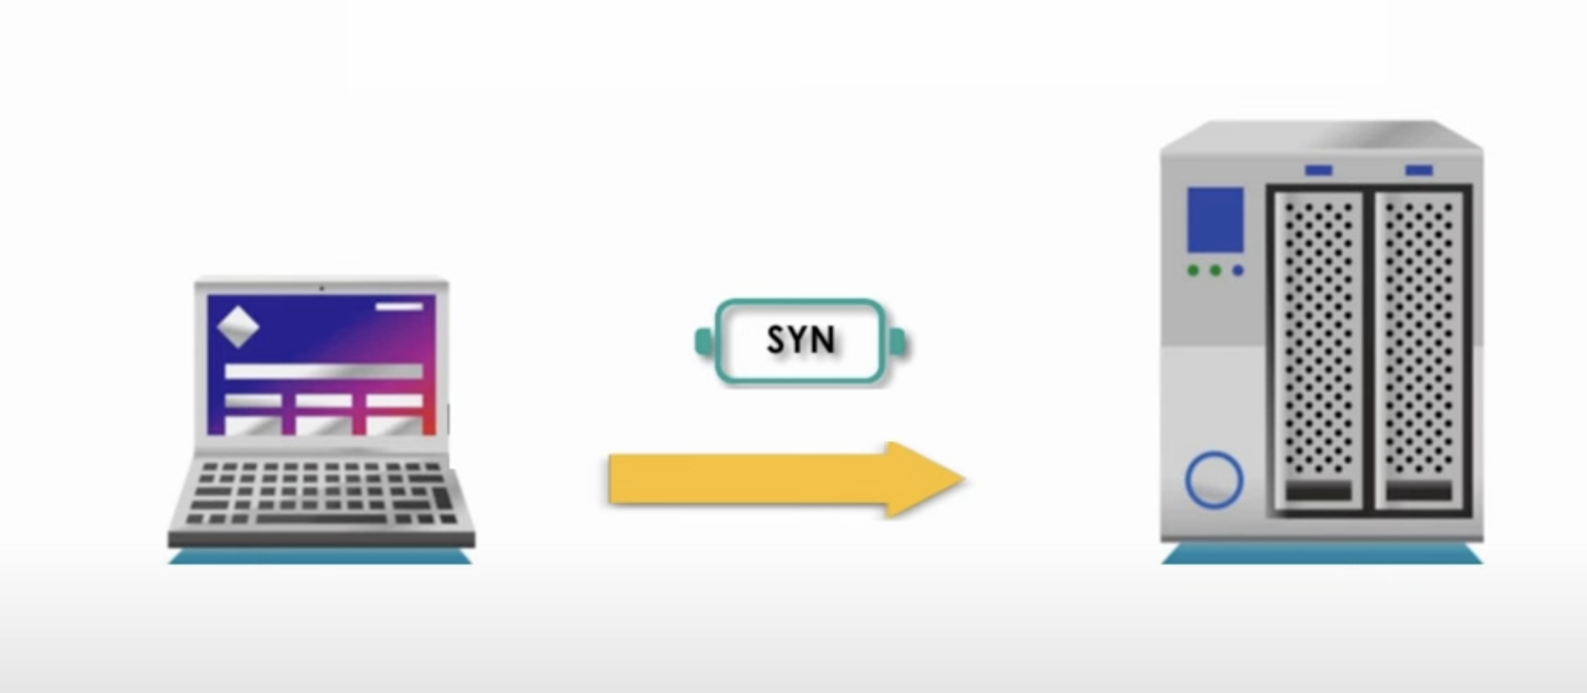
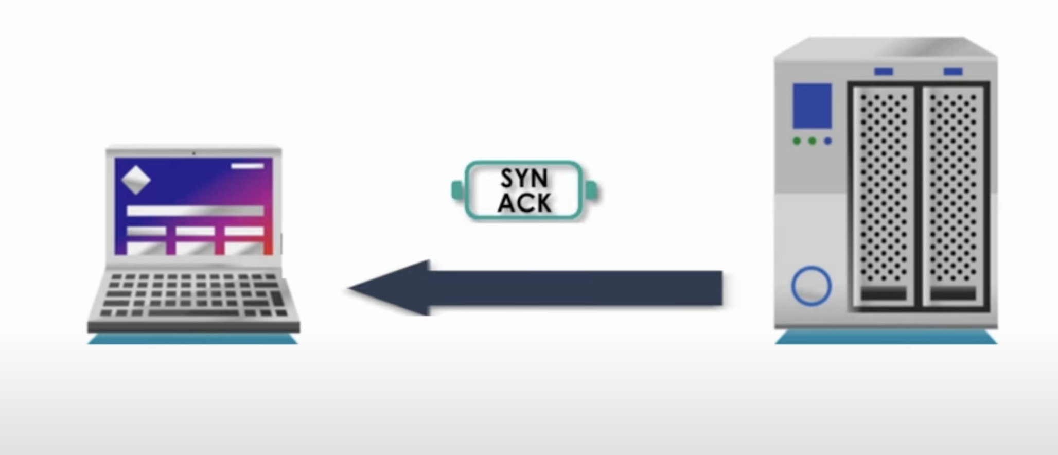

Slide 6
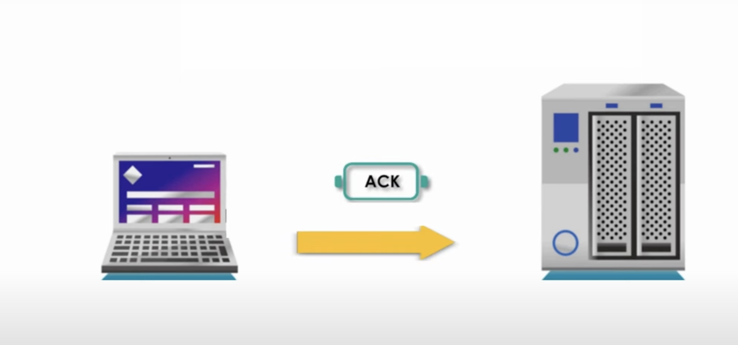
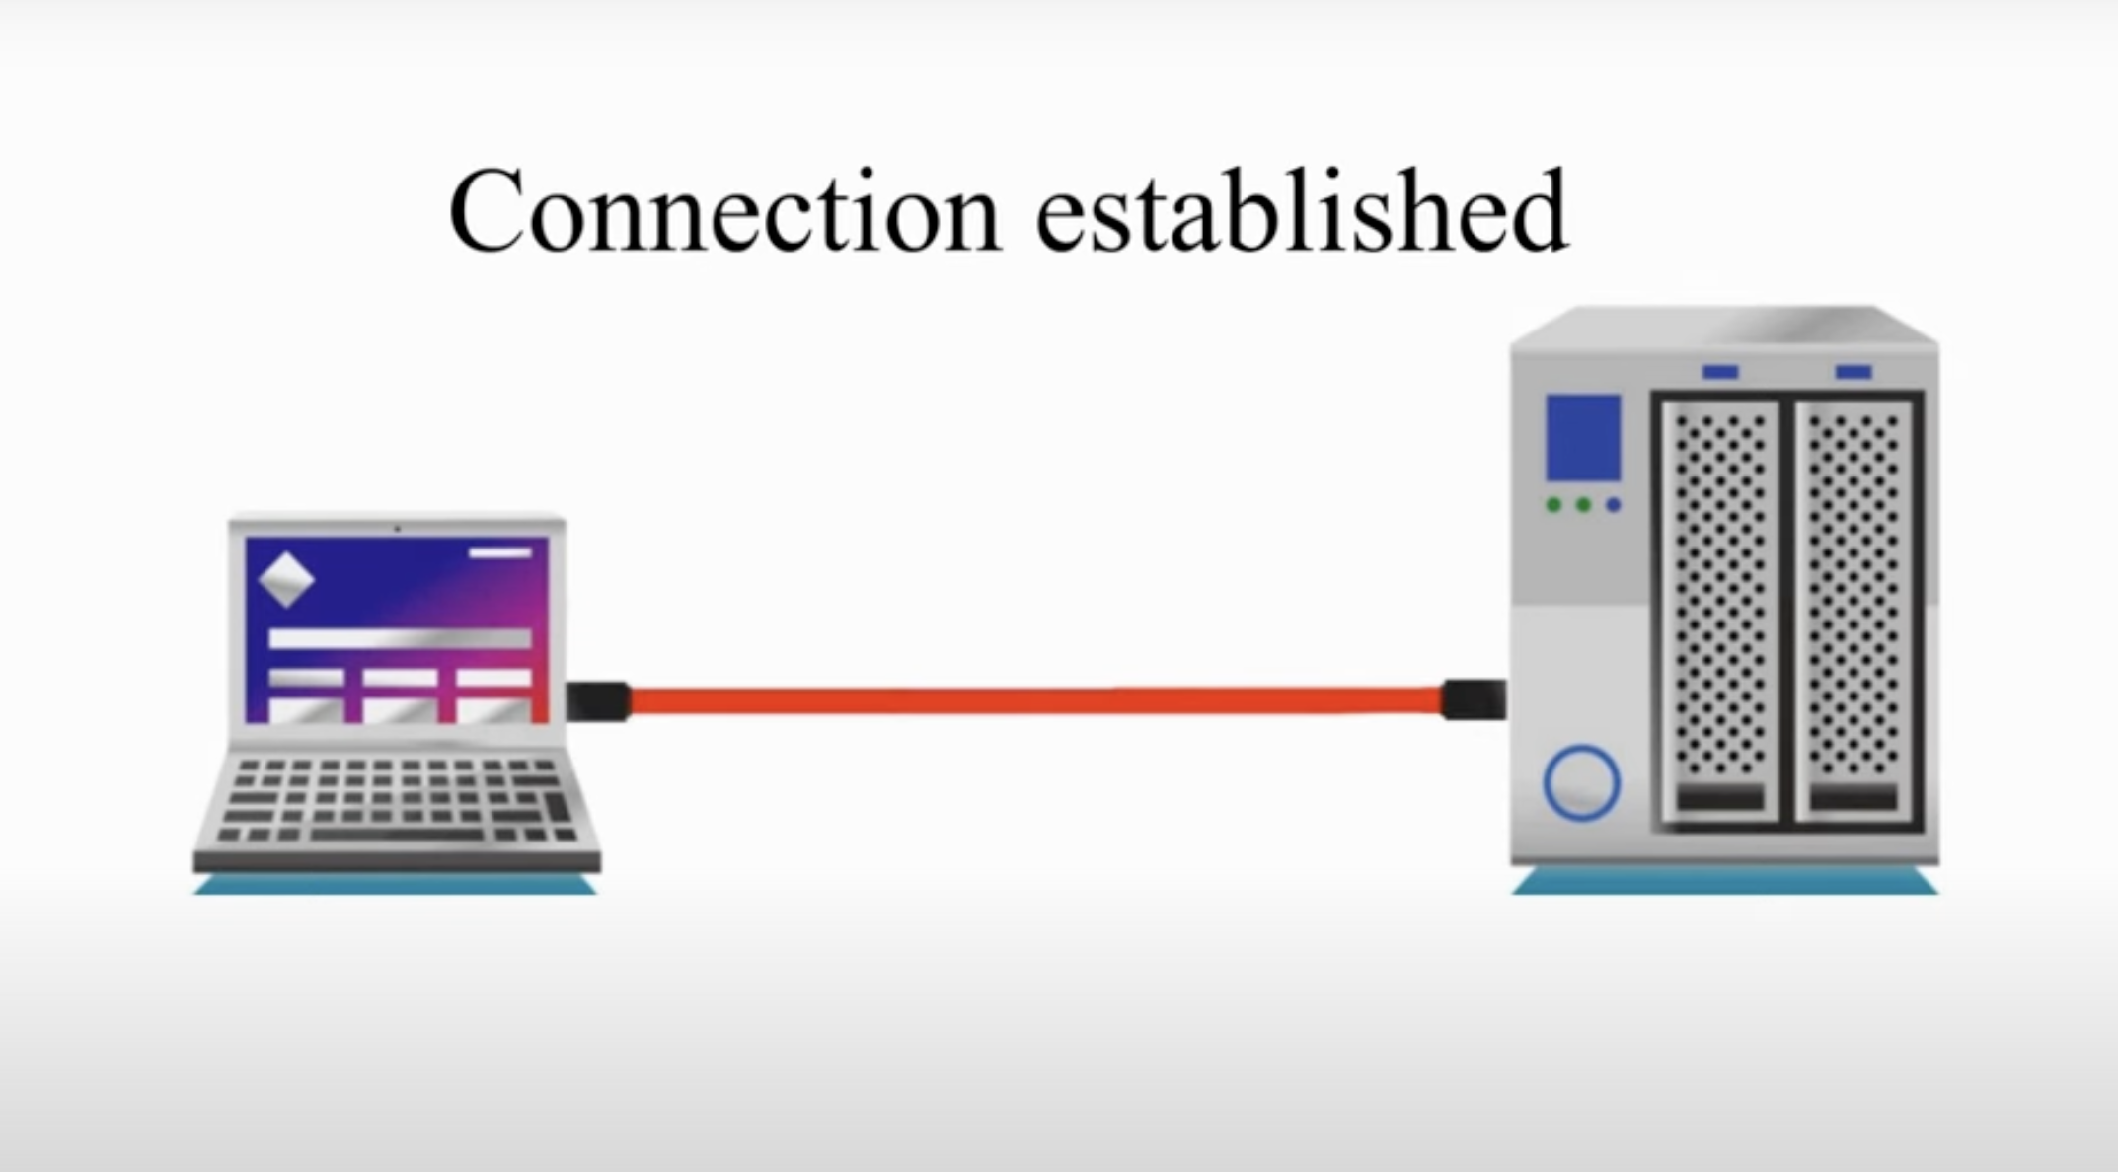

Slide 7
TCP Three-Way Handshake Advantages:
Ensures Reliable Connection – Verifies that both the client and server are ready before communication starts.
Prevents Packet Loss – Confirms data flow before actual transmission.
Error Detection – TCP checks for lost or corrupted packets, improving security.
Supports Encryption (TLS/SSL) – Secure connections (e.g., HTTPS) use TCP for encrypted data transfer.
Disadvantages & Threats:
SYN Flood Attacks (DoS/DDoS) – Attackers send multiple SYN requests but never complete the handshake, overloading the server.
Session Hijacking – Attackers can intercept and take control of a TCP session after a successful handshake.
Man-in-the-Middle (MITM) Attacks – Hackers can intercept and alter data if encryption is not used.

Slide 8
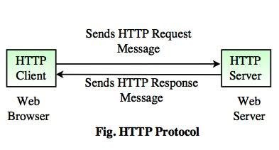
Web Client: Usually a browser (Chrome, Firefox, Safari) that initiates requests.
Web Server: Software (Apache, Nginx, IIS) that processes requests and serves content.
Protocols Used : HTTP/HTTPS over TCP/IP

Slide 9
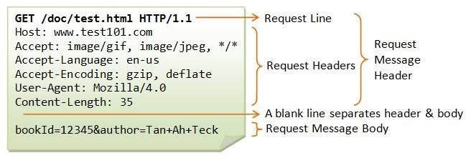
How a Request Works
Step 1: DNS Lookup
The browser translates the URL (e.g., www.example.com) into an IP address.
Step 2: TCP Connection
A three-way handshake (SYN, SYN-ACK, ACK) establishes a reliable connection.
HTTP Request: Once the connection is open, your browser sends an HTTP request to the server. This request typically includes
Request Line: Method (GET, POST, etc.), the path of the resource, and HTTP version.
Headers: Metadata like the browser type, accepted content types, and sometimes cookies.
Body (Optional): For methods like POST, the request may also include data (e.g., form submissions).

Slide 10
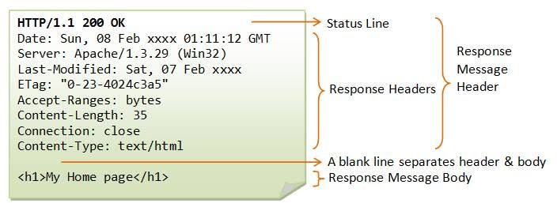
How a Response is Delivered
Server Processing:
The server processes the request (static file retrieval or dynamic content generation).
Response Preparation: After processing the request, the server sends back an HTTP response. This response includes
Status Line: For example, “HTTP/1.1 200 OK” indicating a successful request.
Headers: Information about the content type, caching policies, and more.
Body: The actual content (HTML, CSS, JavaScript, images, etc.) that your browser will display.

Slide 11
How Data Moves Through Protocols (Example: HTTP over TCP/IP)
Application Layer (HTTP, SMTP, FTP, etc.) – A web browser requests a webpage using HTTP.
Transport Layer (TCP, UDP) – The request is broken into packets using TCP (ensuring reliable delivery).
Network Layer (IP, ICMP, etc.) – The packets are assigned an IP address to determine their destination.
Data Link Layer (Ethernet, Wi-Fi, etc.) – The packets are converted into electrical, radio, or optical signals and sent over the network.
Physical Layer – The signals travel through cables or airwaves to reach the destination.

Slide 12
Private Key Encryption(symmetric) Public Key Encryption(asymmetric)
KEY

Slide 13
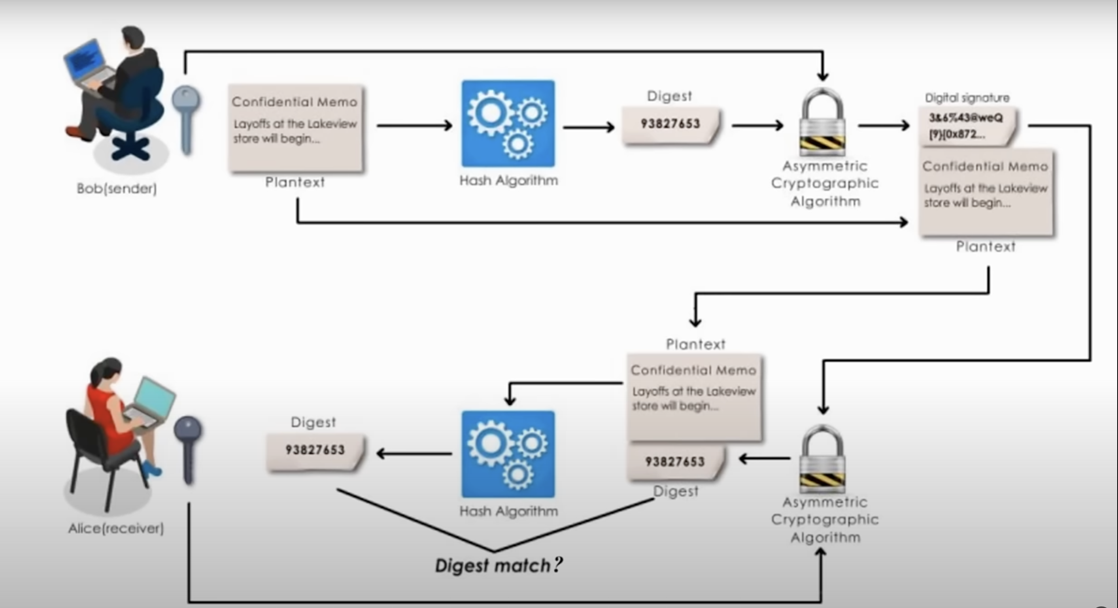
Digital Signature
Digital Signature." A digital signature is a cryptographic technique used to verify the authenticity and integrity of digital messages or documents. It is commonly used for secure communications, electronic transactions, and digital documents.

Slide 14
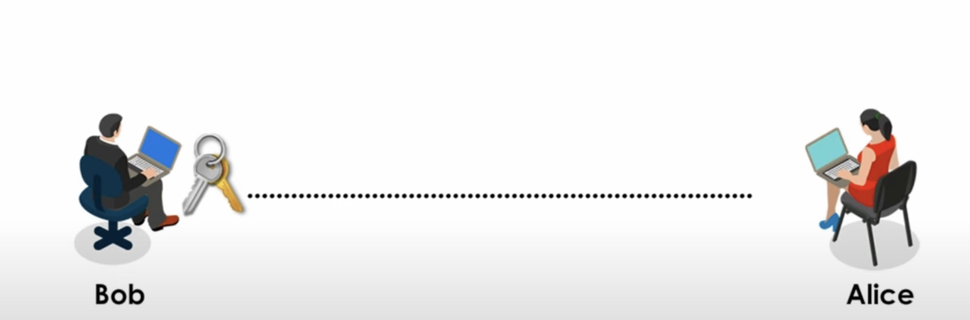
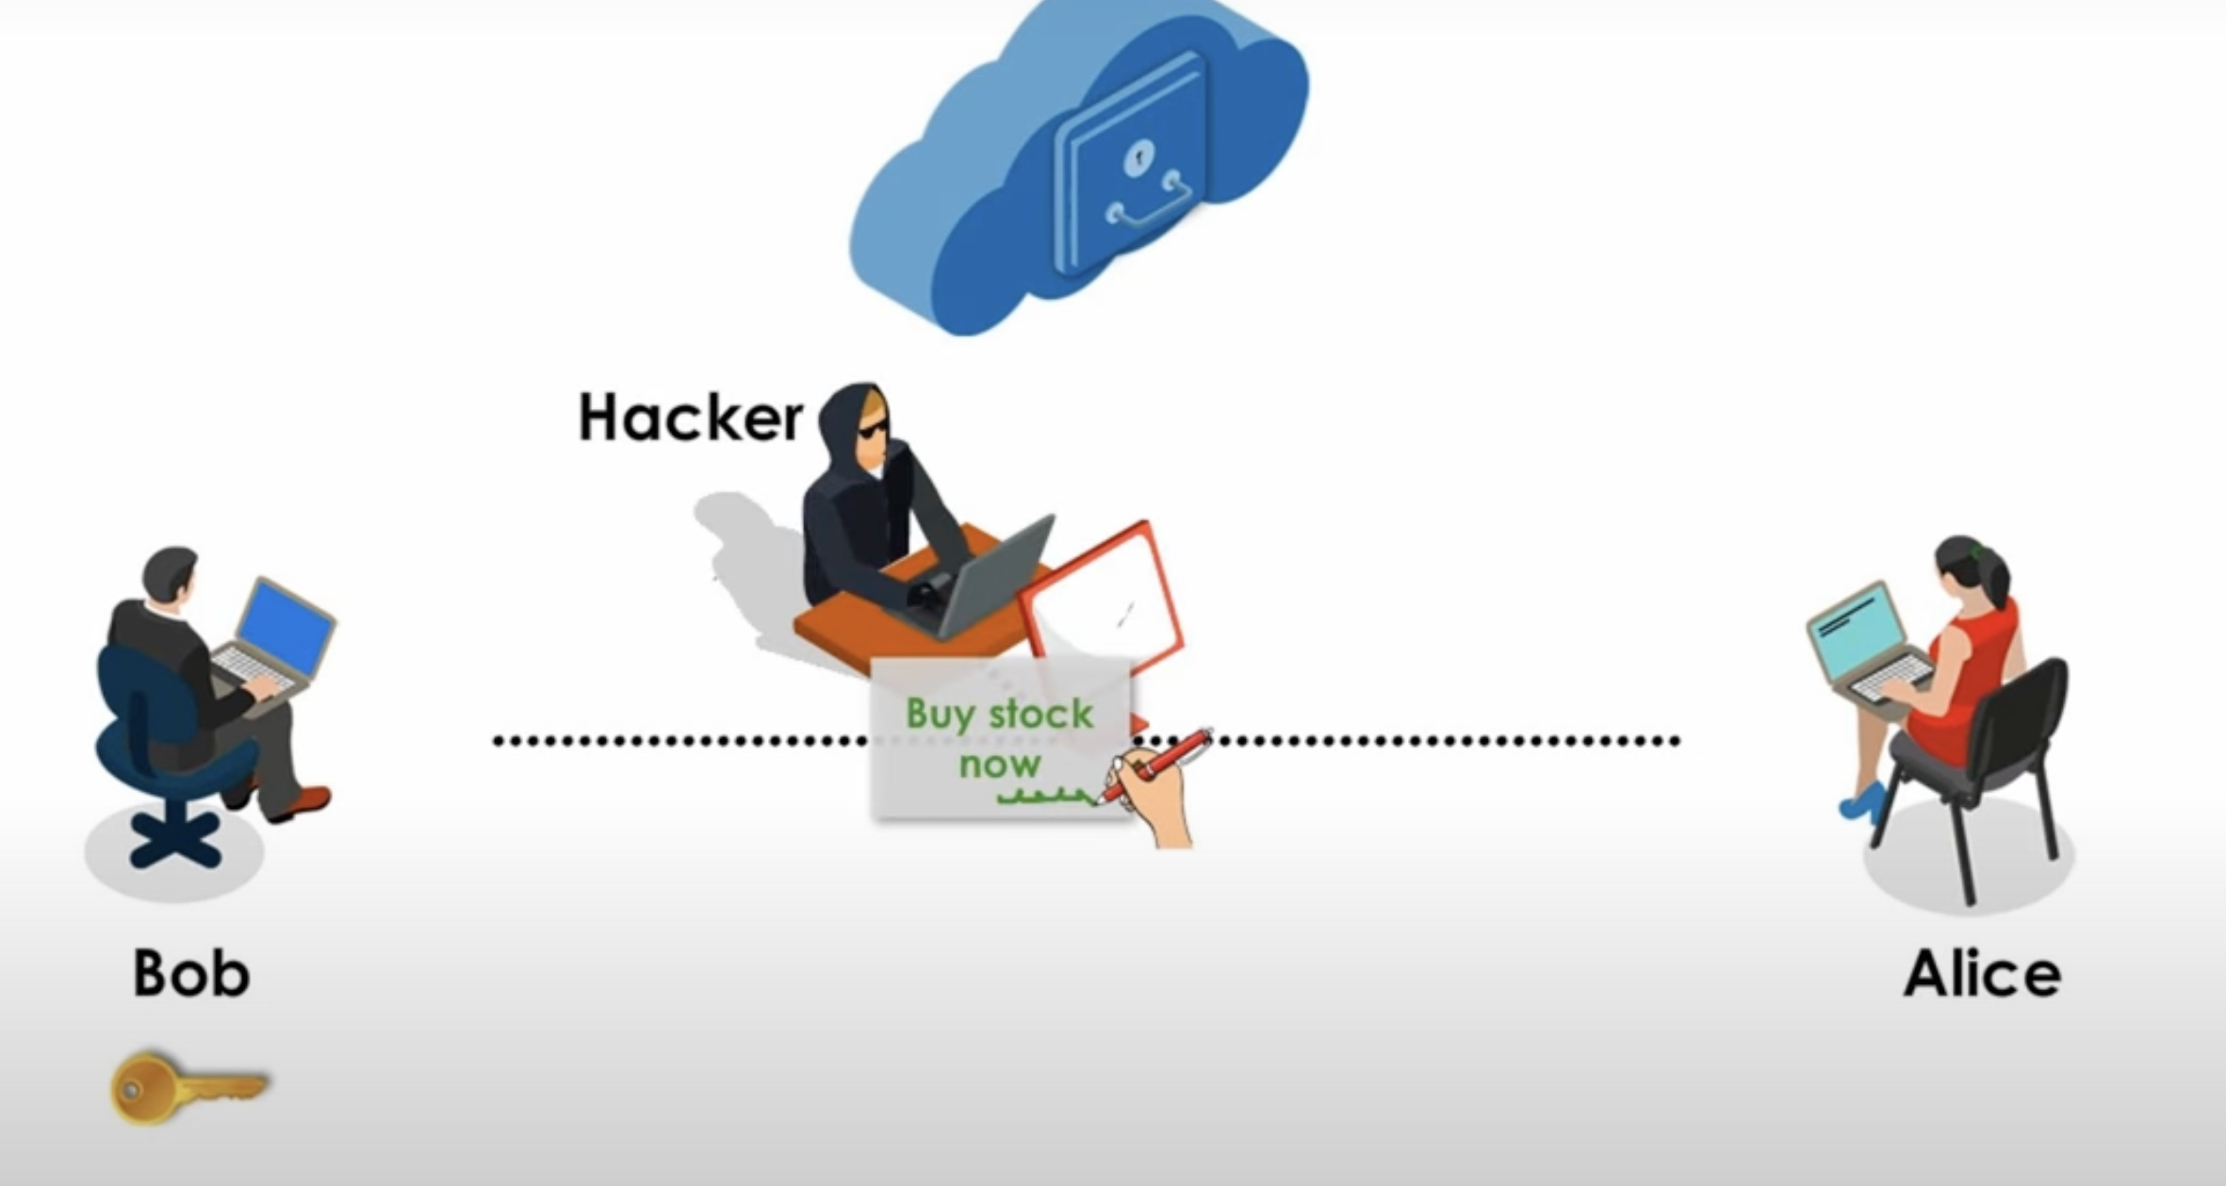
Digital Certificate
Digital Certificate is an electronic document used to prove the ownership of a public key. It is issued by a Certificate Authority (CA) and helps establish trust in online communications, ensuring security and authenticity.

Slide 15
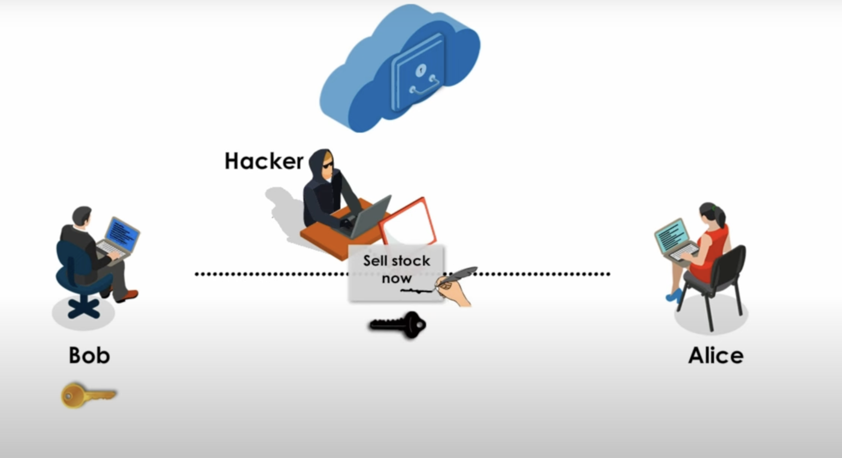
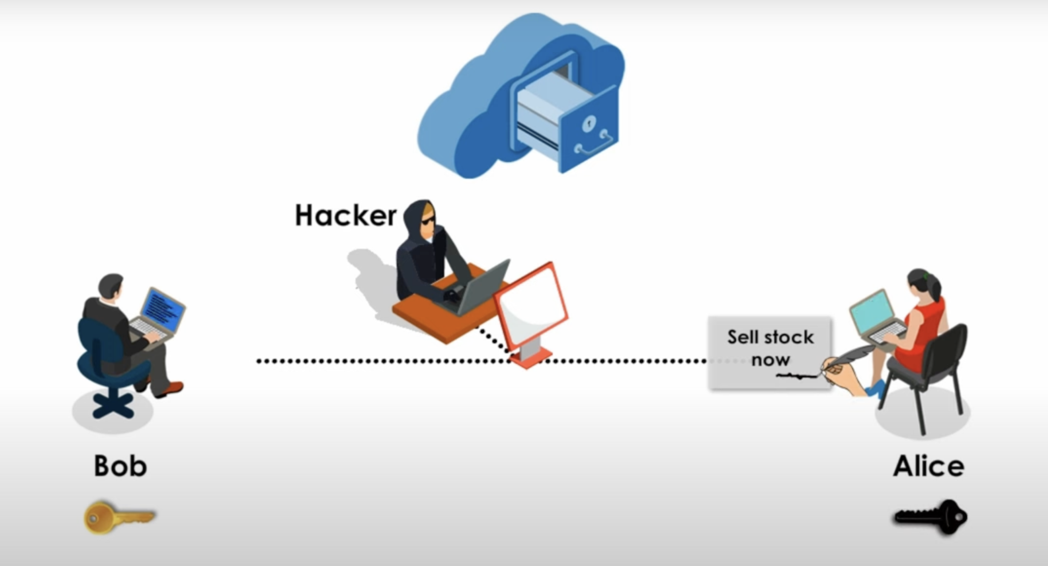

Slide 16
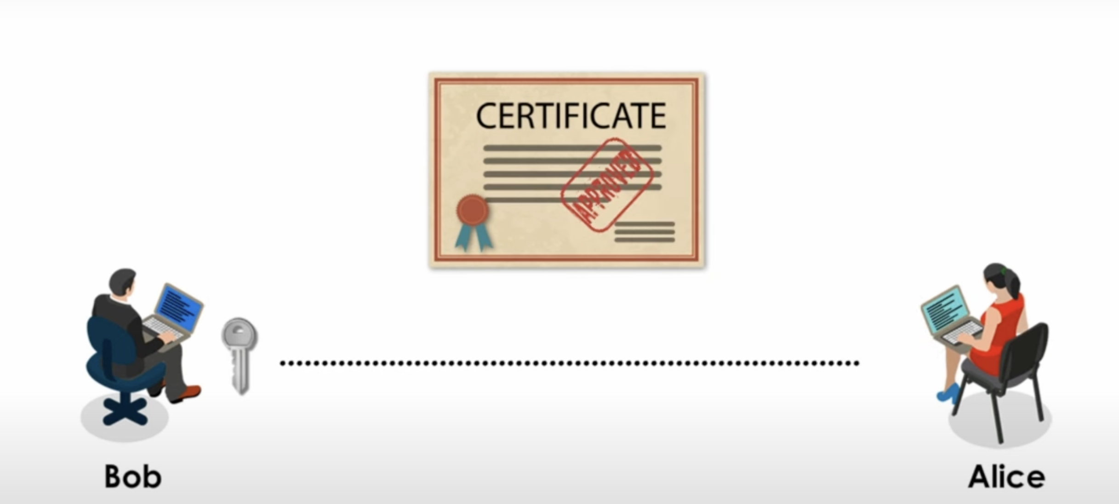
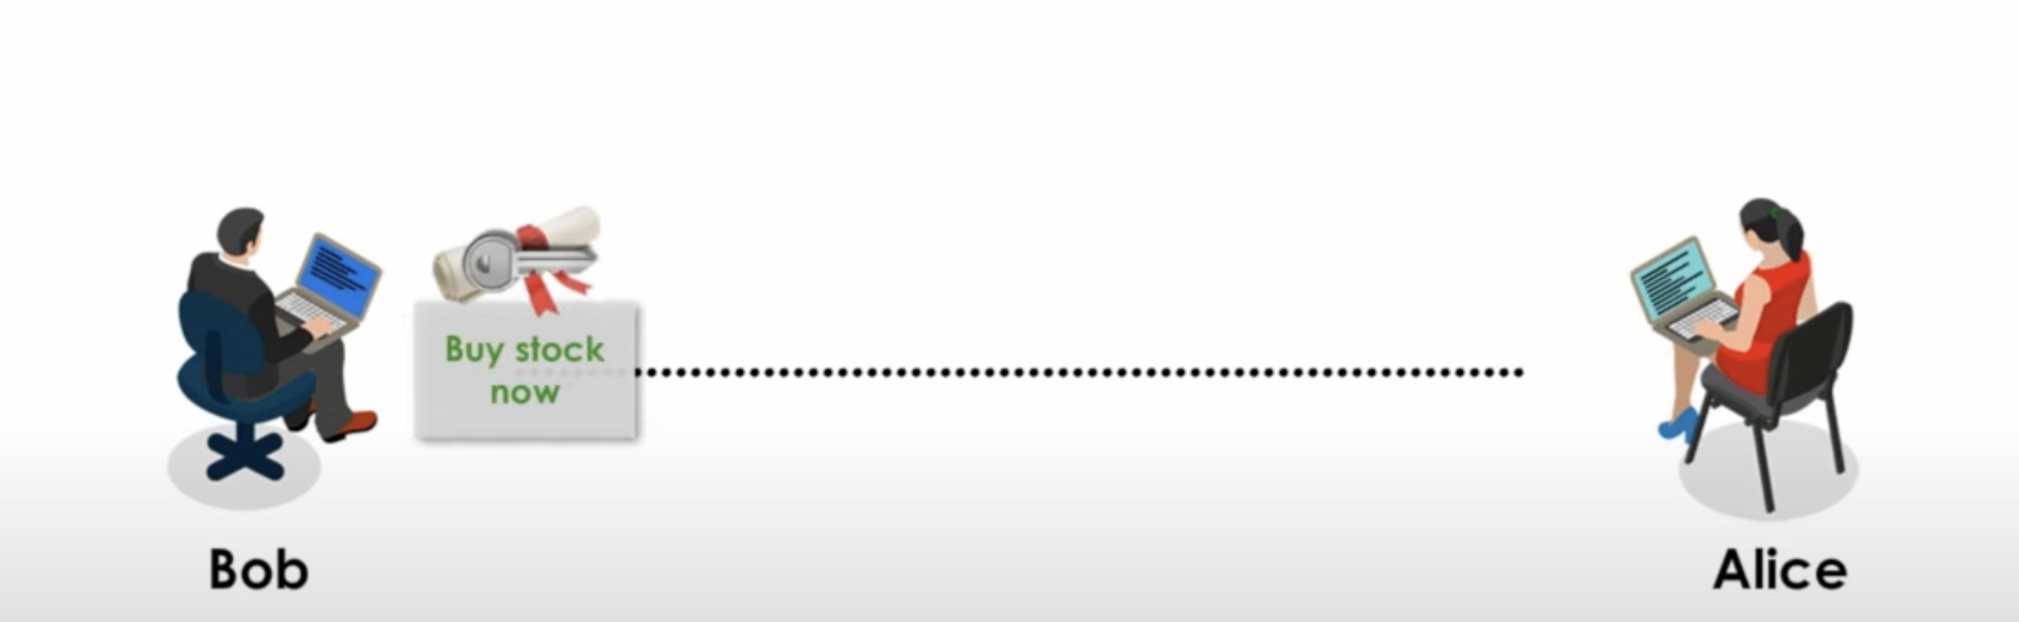

Slide 17
Digital Certificate inclde:
1 Certificate’s owner’s name
2Owner’s public key and its expiration date
3 The certificate issuer’s name
4 The certificate issuer’s digital signature

Slide 18
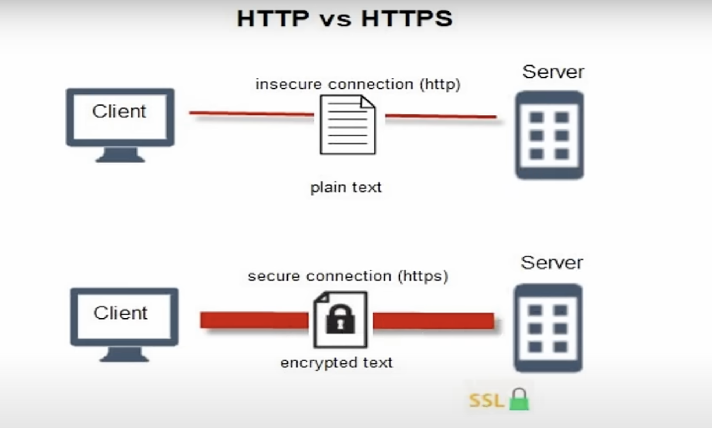
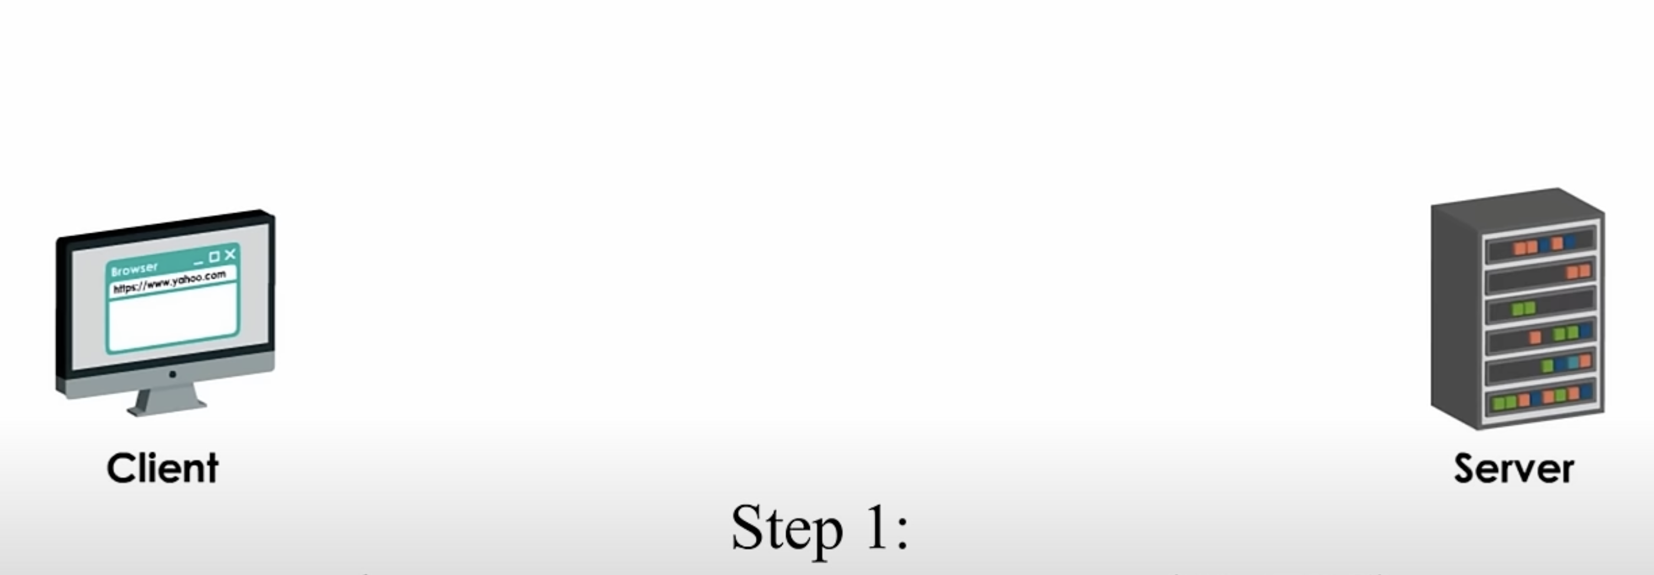
SSL Certificate
SSL Certificate (Secure Sockets Layer Certificate) is a digital certificate that secures data transmitted between a web browser (client) and a website (server) using encryption. It enables HTTPS (Hyper Text Transfer Protocol Secure) and ensures privacy, security, and trust for users.

Slide 19
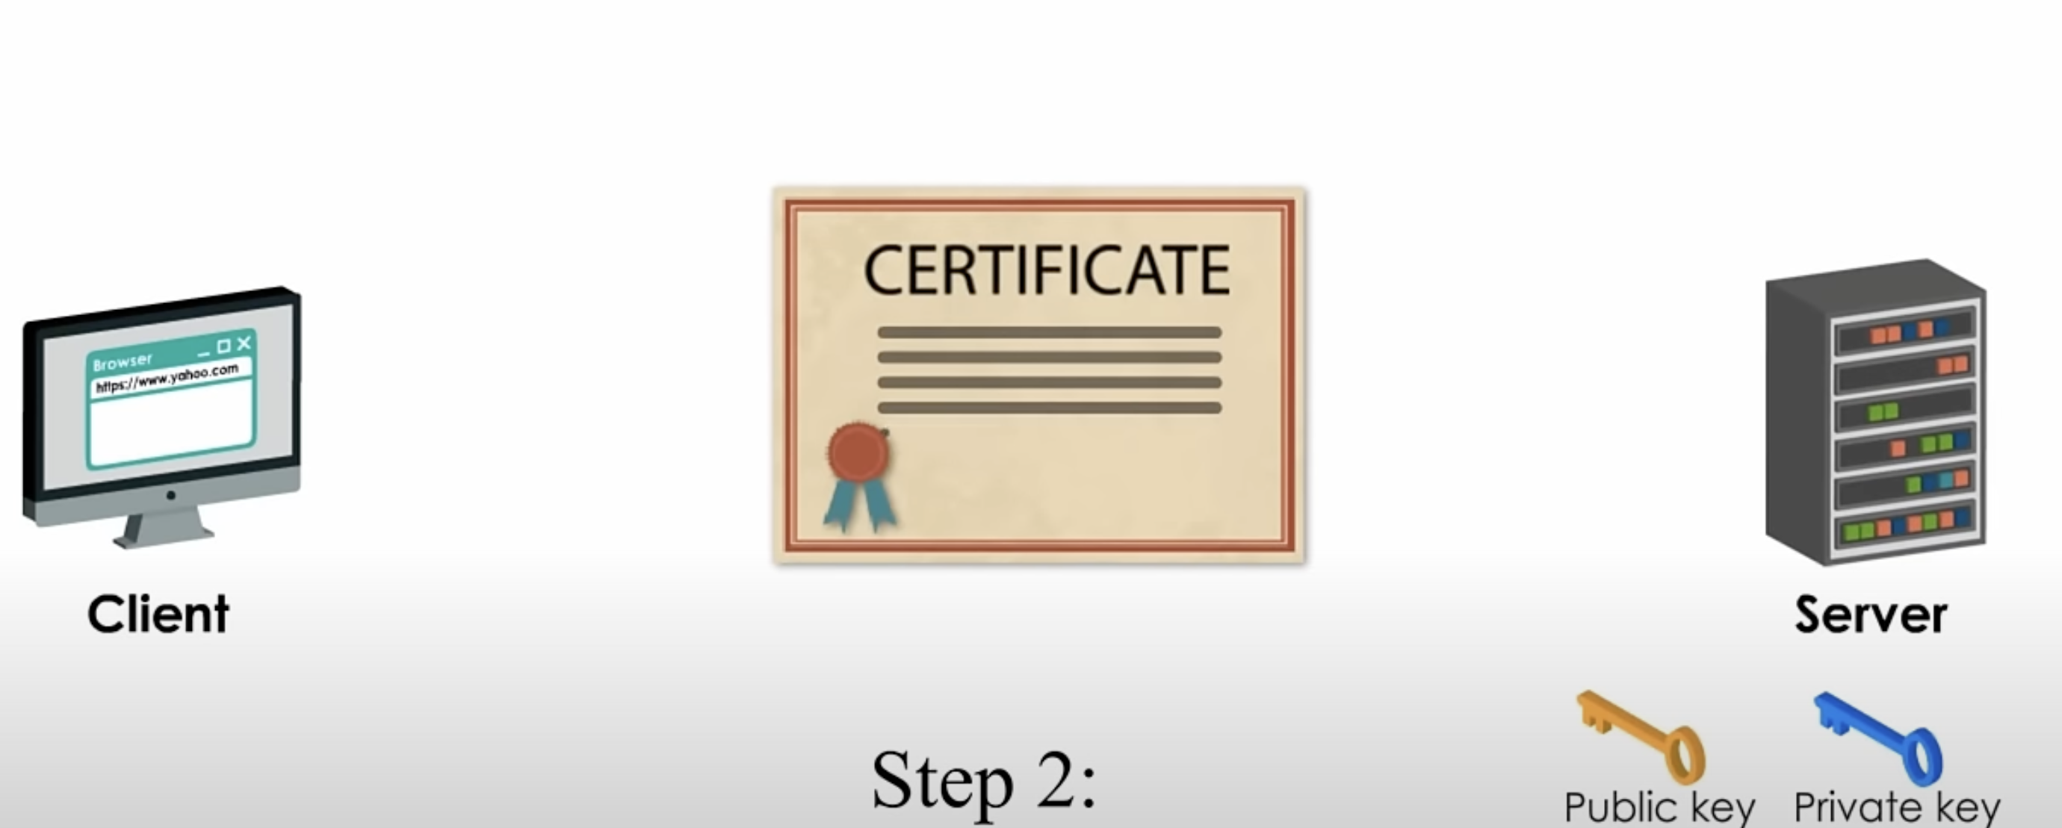
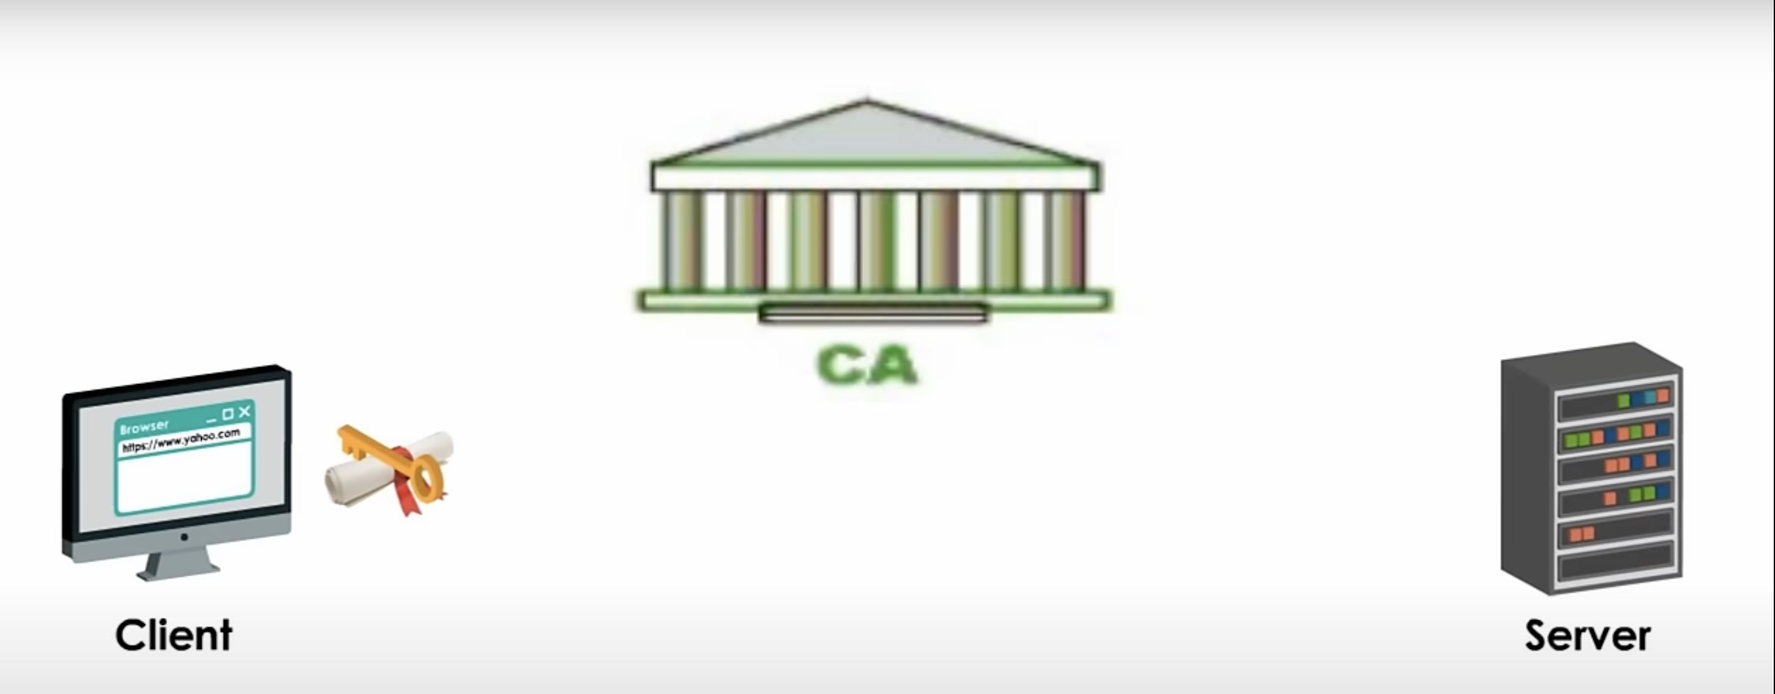

Slide 20
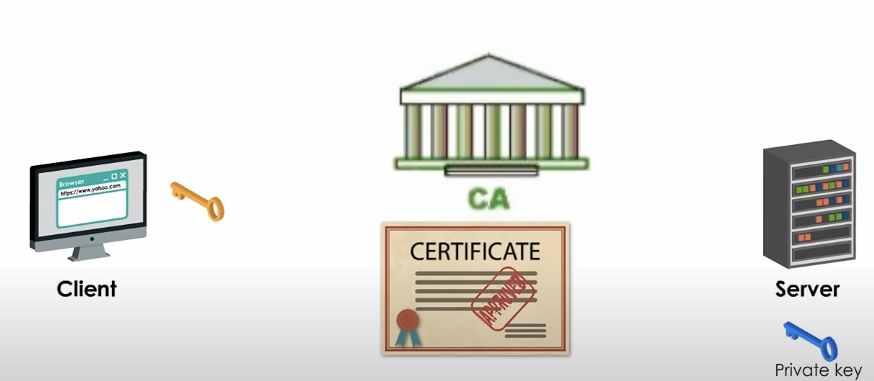
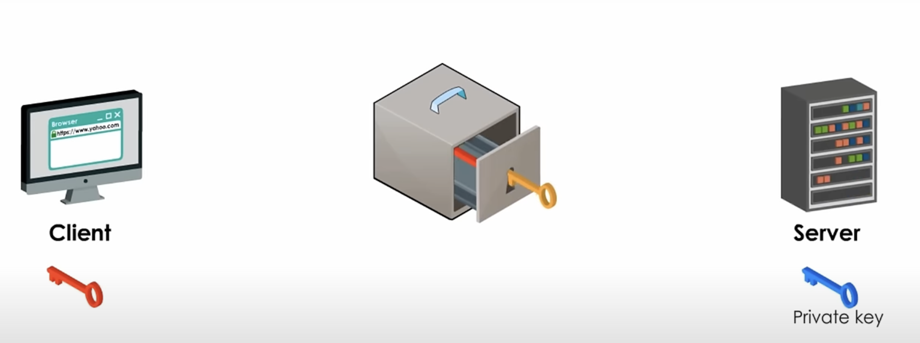
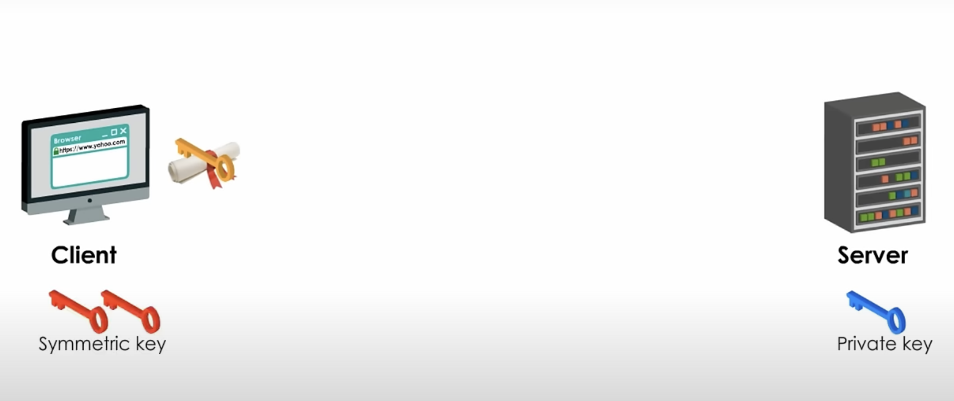
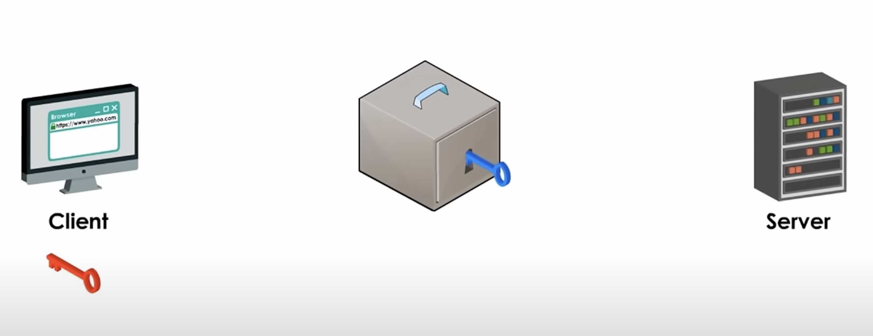

Slide 21
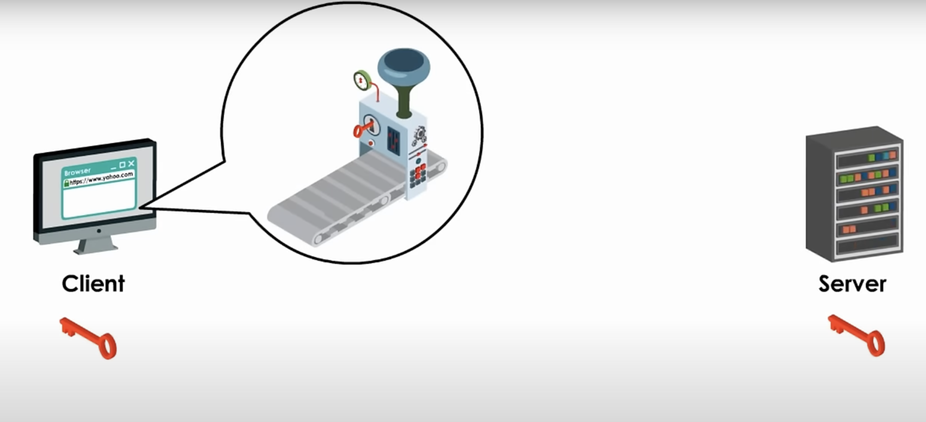

Slide 22
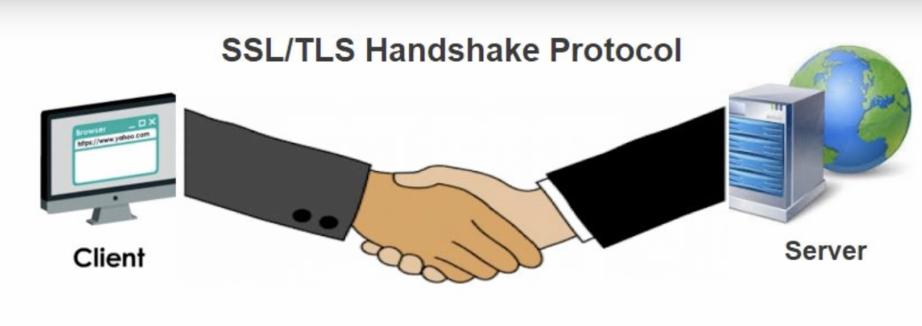
SSL/TLS Handshake Protocol
The SSL (Secure Sockets Layer) / TLS (Transport Layer Security) Handshake is a process used to establish a secure connection between a client (e.g., a web browser) and a server (e.g., a website). It ensures authentication, encryption, and integrity before data is transmitted.

Slide 23
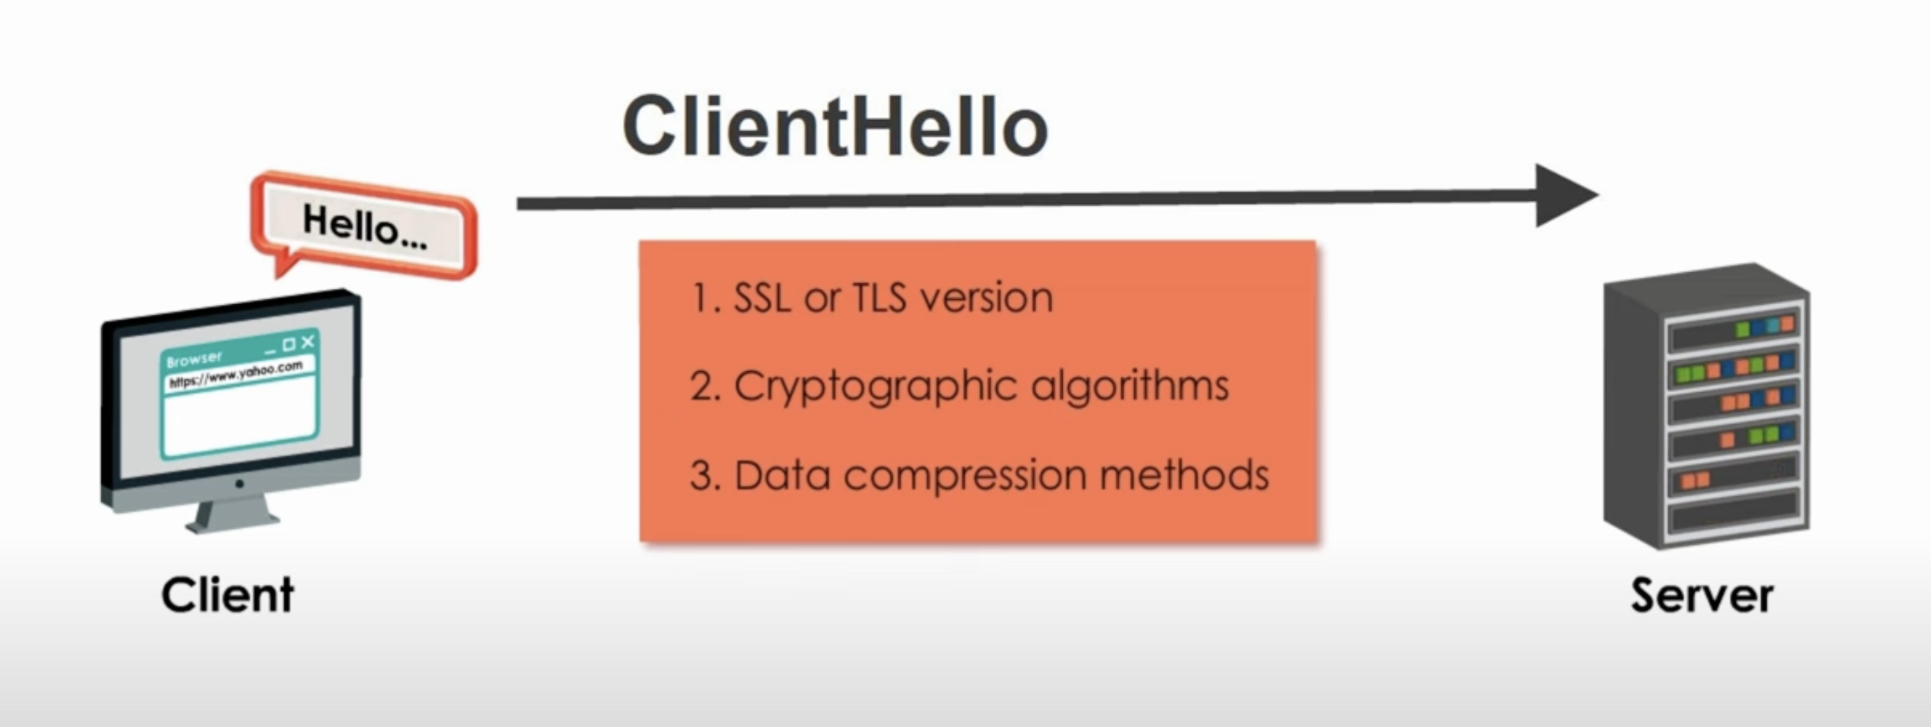
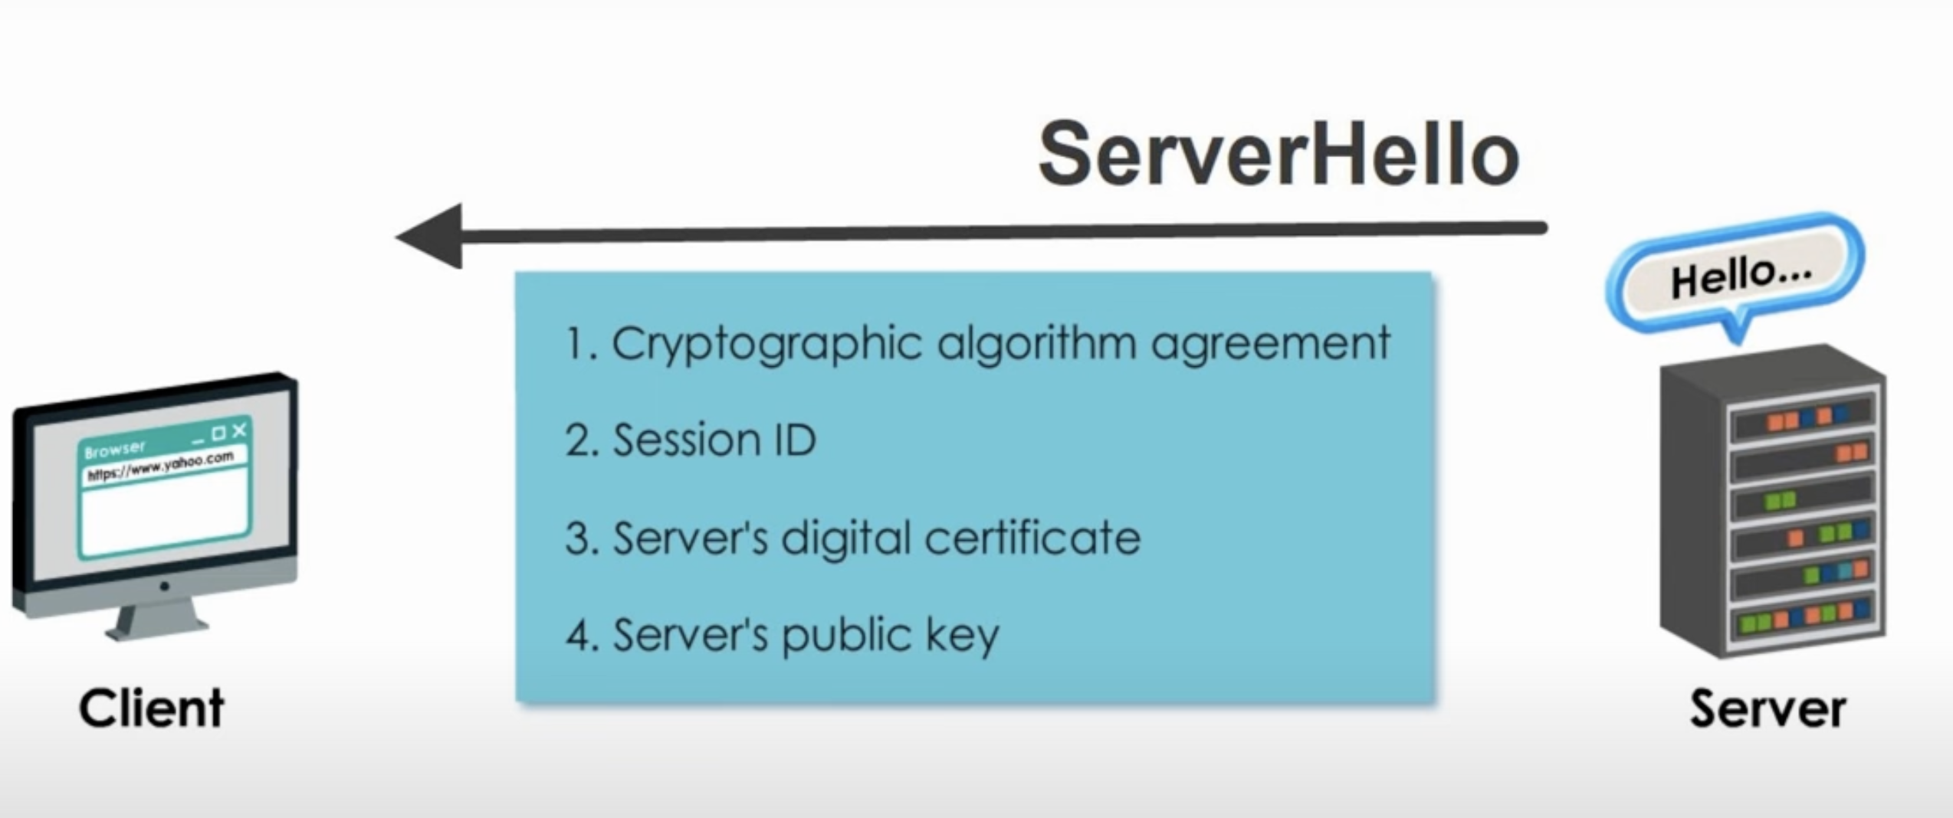

Slide 24
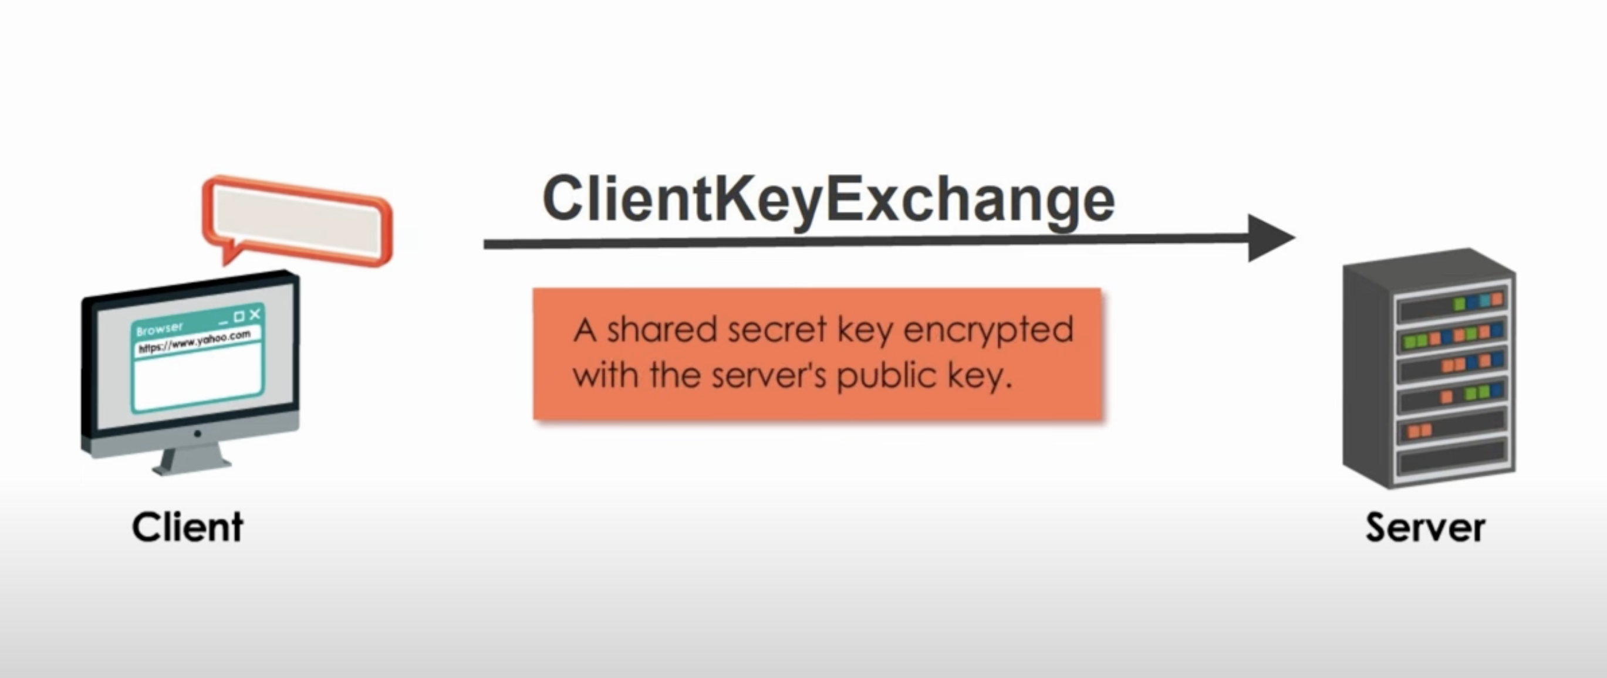
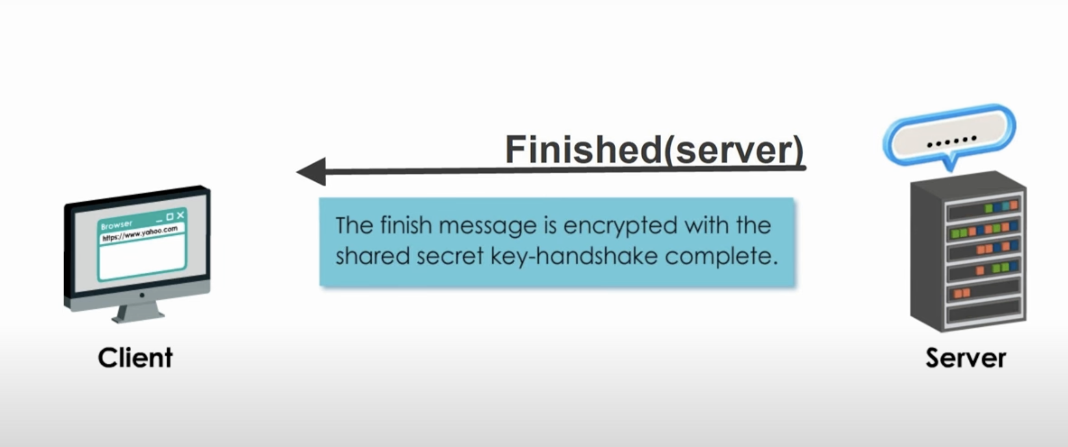
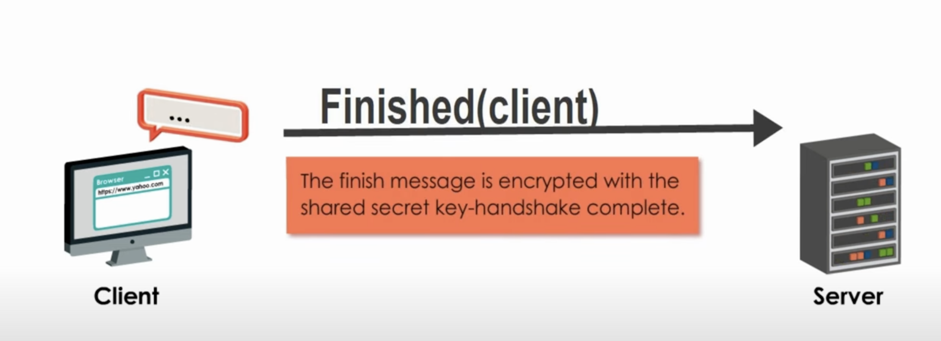
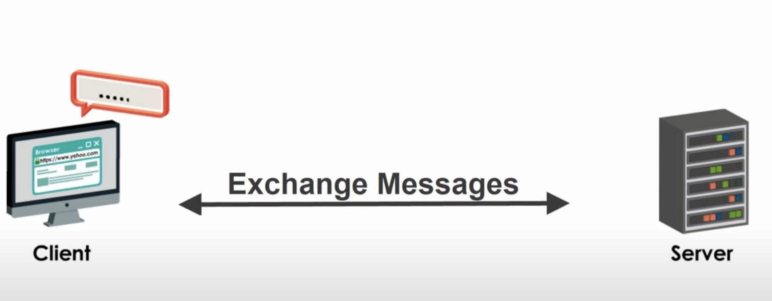
Notes:
Server Authentication & Key Exchange
The client verifies the server’s digital certificate using the CA’s public key.
If the certificate is valid, the handshake continues.
The client and server then agree on a session key for encryption.
4️⃣ Key Exchange & Session Key Generation
TLS 1.2 & older: The client encrypts a pre-master secret using the server’s public key and sends it to the server.
TLS 1.3 (modern version): Uses Diffie-Hellman key exchange for perfect forward secrecy (PFS).
5️⃣ Finished Message & Secure Communication
Both sides generate a session key using the exchanged random numbers and the pre-master secret.
They send a "Finished" message, confirming encryption setup.
Now, all further communication is securely encrypted using symmetric encryption (AES, ChaCha20, etc.).

Slide 25
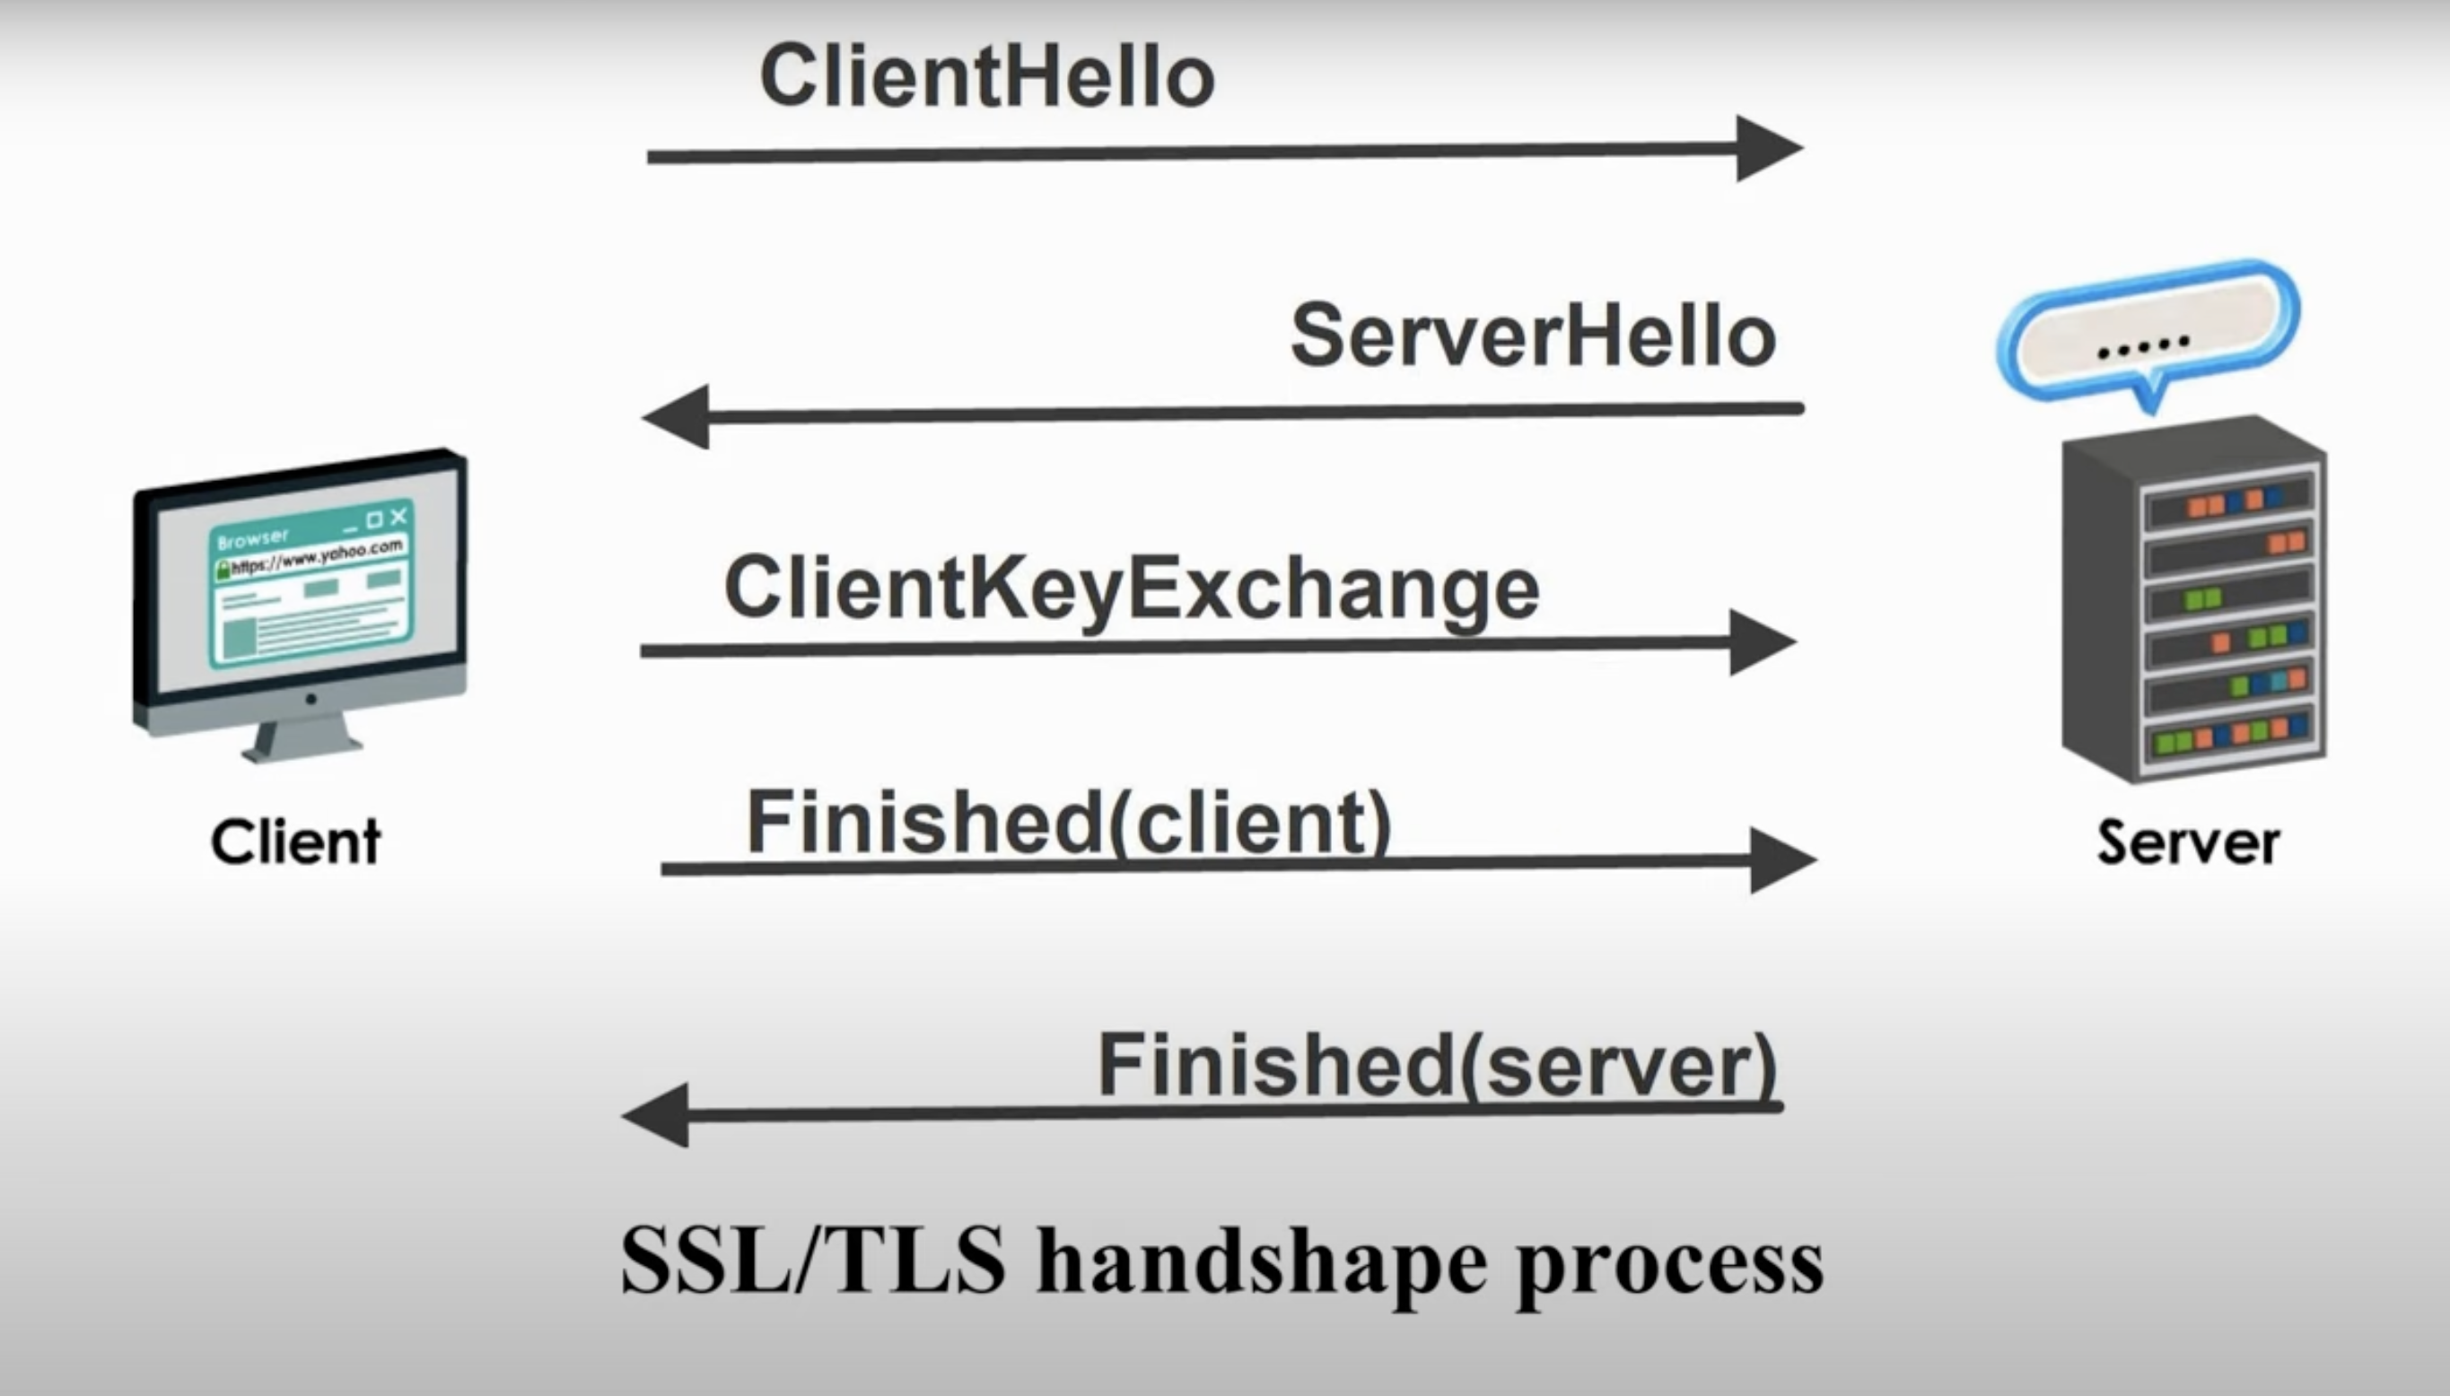

Slide 26
Additional Concepts & Technologies
Persistent Connections:
HTTP/1.1+ supports reusing TCP connections to reduce latency.
Sessions & Cookies:
Used to maintain state across multiple requests.
Dynamic Content & AJAX:
Client-side scripts (JavaScript) can fetch or update data asynchronously.
Security:
HTTPS ensures secure data transfer.
Firewalls, load balancers, and caching optimize performance and security.

Slide 27
Summary Web clients request resources, web servers process and deliver them. Communication is primarily via HTTP/HTTPS over TCP/IP. Modern techniques (AJAX, persistent connections, and cookies) enhance user experience.

